Slide 1

SRM UNIVERSITY ANDHRA PRADESH
“Airline Resevation System”
Submitted by:-
Rohith Kamal Kumar Yenduri AP21110010303
Deekshitha Chirumamilla AP21110010304
Shreyan Dasari AP21110010305

Slide 2
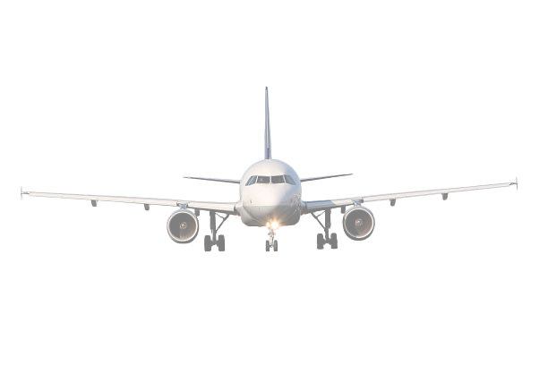
Agenda:-
01. Aim / Objective
02.Abstract
States the purpose of the project
The summary of the whole project
03. Introduction
Breaks down the project into parts
04.System Requirements
Minimum system specifications demanded by the program
05. Algorithm
Explains the steps of the project

Slide 3

AIM/OBJECTIVE
The main objective of the project is to develop online Banking system for online. In present some of airline reservation is done manually. User has to visit airport to book ticket. Some of users may find some difficult to go to airport and get their ticket reserved so in this airport reservation system, we will automate all the booking process. In our airline reservation system user can check available seats, class. In this Software you can keep record of tickets booked. The main purpose of developing airline reservation system is to design an application, which could
store data and provide an interface ticket related details with 100% accuracy. This airline reservation system also allows user to book multiple tickets, cancel ticket. Using this system user can also search any individual seat in few seconds. Our system also provides security check to reduce fraud. The system will check the user’s existence in the database and provide the set of services with respect to the role of the user.
And some other objectives of the system are- ✓ To reduce paperwork. ✓ Reduced operational time. ✓ Increased accuracy and reliability.
✓ Fast Process. ✓ Increased operational efficiency. ✓ Data security.

Slide 4

TOPIC: AIRLINE RESERVATION SYSTEM
ABSTRACT :-
The Airline Reservation System is software developed to avoid manual problems and to make it user-friendly. So it can carry out operations in a smooth and effective manner without any errors. It is also a reliable and fast management system. It also contains better utilization of resources. The aim is to automate the manual system with the computerized equipment and computer software by full-filling their requirements. The airline reservation in C source code is a console application that can let you book seat in flight. User need to enter passport number, name, email, destination, seat number to book ticket. Here user can also cancel the ticket and user can also see the records.

Slide 5
INTRODUCTION
When user entered password then the database will show some options, they are Please enter your choice from below (1-4):
1. Reservation 2. Cancel 3. DISPLAY RECORDS 4. EXIT [and some other options] Feel free to contact
Then user needs to enter his/her choice from the above options. After selecting the option, he/she need to enter the respective details and the operation will be performed successfully.

Slide 6
Algorithm:-
STEP-1: Start STEP-2: DISPLAY welcome to AIRLANE RESERVATION SYSTEM STEP-3: select choice from 1-4 STEP-4: if choice is 1 then
STEP-4.1: write passport number STEP-4.2: write name STEP-4.3: write mail address STEP-4.4: write destination
STEP-5: display seat booking successful and your seat number is STEP-6: if choice is 2 then
STEP-6.1: write passport number to delete record STEP-7: booking has been deleted STEP-8: if choice is 3 then
STEP-8.1: display existing record details STEP-9: if choice is 4 then
STEP-9.1: write Details have been saved to a file STEP-10: if choice is greater than 4 or less than 1 then
STEP-10.1: write SORRY INVALID CHOICE & PLEASE CHOOSE FROM 1-4 & Do not forget to choose from 1-4 STEP-11: STOP

Slide 7

End user:-
This project makes it easy and convenient to reserve plane tickets. Instead of waiting in long lines you can now book tickets at the comfort of your home.
It also saves tons of time and you can also check all the alternate flight options with a click of a button
You will have various airlines to choose from

Slide 8


